Slide 1
FRB Update
William Huang
(7/17/2020)

Slide 2
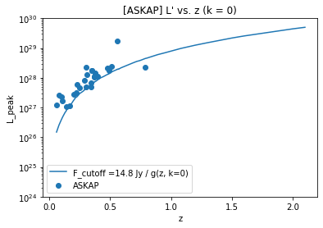
ASKAP Higher Limit
For the FRBs from ASKAP, I changed from a limit of 7.7 Jy to a limit of 14.8 Jy, which cuts off some of the sources but is also more representative of the actual limiting flux. I did not include the FRBs below the cutoff in my calculations of kendall tau.

Slide 3
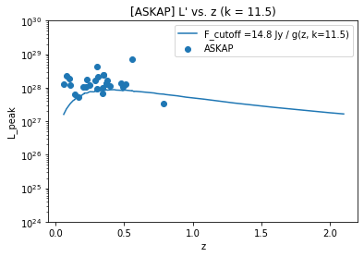
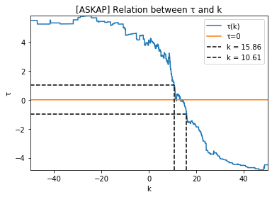
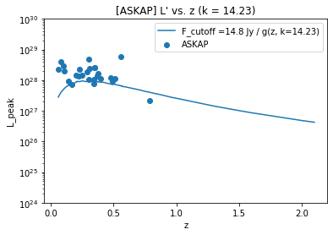
(cont.)
Kendall tau intersects 0 multiple times, but both k values are still in double digits, and the limits are not monotonic.

Slide 4
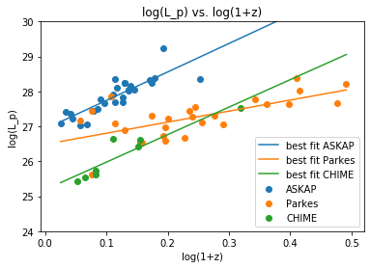
Fitting log(L_p) vs. log(1+z)
Fitting the best fit linear line for log(L_p) versus log(1+z), we find that
ASKAP slope = 8.153
Parkes slope = 3.165
CHIME slope = 7.870

Slide 5


Calculating Kendall Tau for L_p vs. L_{p,lim}
The process:
for a certain value of k, I transform both L_p and L_{p,lim} using g(z) to obtain L’ and L_{p,lim}’
The limiting luminosity line L_p = L_{p,lim} should still be the same since both luminosities are transformed by g(z)
Then, I calculate kendall tau between L’ and L_{p, lim}’

Slide 6
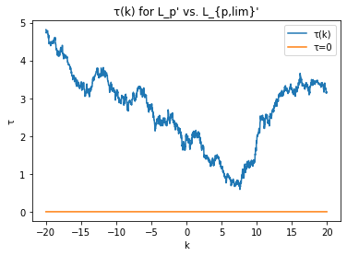
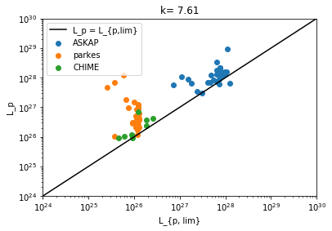
(cont.)
After changing the flux limit for ASKAP to 14.8 Jy, the kendall tau graph looks largely the same, although it does approach 0 more closely.

